Slide 1
ANLY 5332
Department of Information Systems and Analytics
McCoy College of Business
Texas State University
Decision Analysis and Stochastic/Robust Optimization

Slide 2
Outline
Decision Criteria (Chapter 9.1 & 9.2)
Decision Trees and Value of Information (Chapter 9.3-9.7)
Utility Theory Review (Chapter 9.8)
Stochastic Optimization Overview (not in the textbook)
Robust Optimization Overview (not in the textbook)
Probability Basics Review
Self-Study

Slide 3
Outline
Decision Criteria (Chapter 9.1 & 9.2)
Decision Trees and Value of Information (Chapter 9.3-9.7)
Utility Theory Review (Chapter 9.8)
Stochastic Optimization Overview (not in the textbook)
Robust Optimization Overview (not in the textbook)
Probability Basics Review

Slide 4
Decision Analysis
Managers often need to make decisions under uncertainty
  Introducing a new product
  A financial firm’s investment decisions
  Agricultural firm’s mix of crop planning
  Oil company’s drilling decisions
  Storage Wars!!!!

Slide 5
Decision Analysis
Case: The Goferbroke Company Problem (Chapter 9.1)
  The Goferbroke Company develops oil wells in unproven territory
    A consulting geologist has reported that there is a one-in-four chance of oil on a particular tract of land.
    Drilling for oil on this tract would require an investment of about $100,000.
    If the tract contains oil, it is estimated that the net revenue generated would be approximately $800,000.
    Another oil company has offered to purchase the tract of land for $90,000.
  Question: Should Goferbroke drill for oil or sell the tract?
  Prospective profits:
 | Profit
Status of Land | Oil | Dry
Alternative
Drill for oil | $700,000 | –$100,000
Sell the land | 90,000 | 90,000
Chance of status | 1 in 4 | 3 in 4

Slide 6
Decision Analysis
Some terminology:
  The decision maker is the individual or group responsible for making the decision.
  The alternatives are the options for the decision to be made.
  The outcome is affected by random factors outside the control of the decision maker. These random factors determine the situation that will be found when the decision is executed. Each of these possible situations is referred to as a possible state of nature.
  The decision maker generally will have some information about the relative likelihood of the possible states of nature. These are referred to as the prior probabilities.
  Each combination of a decision alternative and a state of nature results in some outcome. The payoff is a quantitative measure of the value to the decision maker of the outcome. It is often the monetary value.

Slide 7
Decision Analysis
Case: The Goferbroke Company Problem (Chapter 9.1)
The decision maker generally will have some information about the relative likelihood of the possible states of nature. These are referred to as the prior probabilities.
Each decision alternative can have different values (payoffs) under different states of nature
State of Nature | Prior Probability
The tract of land contains oil | 0.25
The tract of land is dry (no oil) | 0.75
 | State of Nature
Alternative | Oil | Dry
Drill for oil | $700K | $–100K
Sell the land | $90K | $90K
Prior probability | 0.25 | 0.75
Payoff Table

Slide 8
Decision Criteria
When we have certainty, we can use
  Linear, integer, binary, nonlinear programming, …
What if we do not have certainty?
  Uncertainty vs. Risk
    Uncertainty: Probabilities are not known
    Risk (Stochastic): Probabilities are known
  We can still use mathematical programming for both cases
    Robust Optimization for uncertainty vs. Stochastic Optimization for risk
There are also simple decision rules that can be used to compare options
  Decision Making under Uncertainty
  Decision Making under Risk

Slide 9
Decision Making under Uncertainty
Maximax Criterion
  The maximax criterion is the decision criterion for the eternal optimist.
  It focuses only on the best that can happen.
  Plan for the best worst case
  Procedure:
    Identify the maximum payoff from any state of nature for each alternative.
    Find the maximum of these maximum payoffs and choose this alternative.
  Case: The Goferbroke Company Problem
 | State of Nature
Alternative | Oil | Dry | Maximum in Row
Drill for oil | 700 | –100 | 700 ← Maximax
Sell the land | 90 | 90 | 90
Under Maximax criterion, you should drill for oil.

Slide 10
Decision Making under Uncertainty
Maximax Criterion
  Case: Another example (not in the textbook)
Future state | F₁ | F₂ | F₃
Alternative |  | (Payoff)
A₁ | 100 | 100 | 400
A₂ | -200 | 150 | 600
A₃ | 0 | 200 | 500
A₄ | 100 | 300 | 200
A₁
A₂
A₃
A₄
Best Best Case
400 (j=3)
600 (j=3)
500 (j=3)
300 (j=2)
i
j
Payoff
(Adapted From: Blanchard and Fabrycky, “System Engineering and Analysis, Prentice Hall, 1998)

Slide 11
Decision Making under Uncertainty
Maximin Criterion
  The maximin criterion is the decision criterion for the total pessimist.
  It focuses only on the worst that can happen.
  Plan for the best worst case
  Procedure:
    Identify the minimum payoff from any state of nature for each alternative.
    Find the maximum of these minimum payoffs and choose this alternative.
  Case: The Goferbroke Company Problem
 | State of Nature
Alternative | Oil | Dry | Minimum in Row
Drill for oil | 700 | –100 | –100
Sell the land | 90 | 90 | 90 ← Maximin
Under Maximin criterion, you should sell the land.

Slide 12
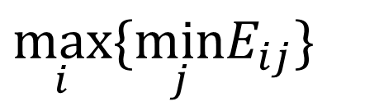
Decision Making under Uncertainty
Maximin Criterion
  Case: Another example (not in the textbook)
Future state | F₁ | F₂ | F₃
Alternative |  | (Payoff)
A₁ | 100 | 100 | 400
A₂ | -200 | 150 | 600
A₃ | 0 | 200 | 500
A₄ | 100 | 300 | 200
A₁
A₂
A₃
A₄
Best Worst Case
100 (j=1 or 2)
-200 (j=1)
0 (j=1)
100 (j=1)
i
j
$$\max_{i}\{\min_{j}E_{ij}\}$$
Payoff
(Adapted From: Blanchard and Fabrycky, “System Engineering and Analysis, Prentice Hall, 1998)

Slide 13
Decision Making under Uncertainty
Laplace Criterion (equally likely criterion)
  Assumes that probability of each occurrence is identical
  Procedure:
    Assign equal probabilities to the states of natures (sum of the probabilities will be 1).
    Calculate the expected payoff for each alternative (average payoff for the alternative)
    Choose the alternative with the best payoff.
  Case: The Goferbroke Company Problem
 | State of Nature
Alternative | Oil | Dry | Average Payoff
Drill for oil | 700 | –100 | 300 ← Max Average
Sell the land | 90 | 90 | 90
Under Laplace criterion, you should drill for oil.

Slide 14
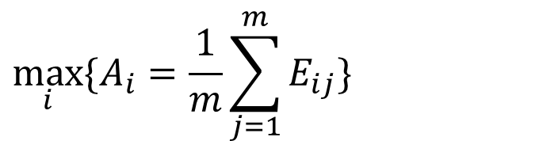
Decision Making under Uncertainty
Laplace Criterion (not in the book)
  Case: Another example (not in the textbook)
Future state | F₁ | F₂ | F₃
Alternative |  | (Payoff)
A₁ | 100 | 100 | 400
A₂ | -200 | 150 | 600
A₃ | 0 | 200 | 500
A₄ | 100 | 300 | 200
A₁
A₂
A₃
A₄
Average Payoff
200
183.33
233.33
200
i
j
$$\max_{i}\{A_{i}=\frac{1}{m}\sum_{j=1}^{m}{E_{ij}}\}$$
n: number of alternatives
m: number of states of nature
(Adapted From: Blanchard and Fabrycky, “System Engineering and Analysis, Prentice Hall, 1998)
Avg. Payoff for alternative i

Slide 15
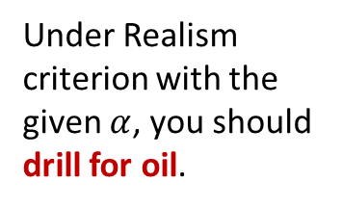
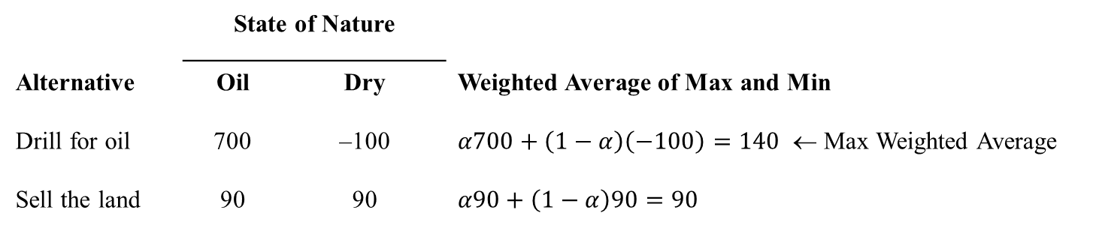

Decision Making under Uncertainty
Realism – Hurwicz Criterion (not in the book)
  Combination of maximin and maximax
  Procedure:
    Give a weight for the maximum and minimum of the alternatives ($α$ vs. $1−α$)
    Calculate the weighted average of the maximum and minimums
    Pick the one with the best weighted average payoff
  Case: The Goferbroke Company Problem
    Say $α=0.3$ and $1−α=0.7$ so, more pessimistic!
 | State of Nature
Alternative | Oil | Dry | Weighted Average of Max and Min
Drill for oil | 700 | –100 | $α700+\left(1−α\right)\left(−100\right)=140$ ← Max Weighted Average
Sell the land | 90 | 90 | $α90+\left(1−α\right)90=90$
Under Realism criterion with the given $α$, you should drill for oil.

Slide 16
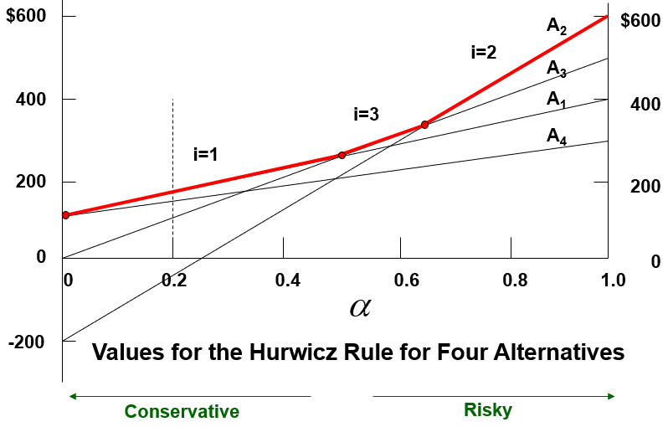
Decision Making under Uncertainty
Realism – Hurwicz Criterion (not in the book)
  Case: Another example (not in the textbook)
Future state | F₁ | F₂ | F₃
Alternative |  | (Payoff)
A₁ | 100 | 100 | 400
A₂ | -200 | 150 | 600
A₃ | 0 | 200 | 500
A₄ | 100 | 300 | 200
i
j
(Adapted From: Blanchard and Fabrycky, “System Engineering and Analysis, Prentice Hall, 1998)

Slide 17
Decision Making under Uncertainty
When you have no information about probabilities
  Maximax (ultimate optimistic)
  Maximin (ultimate pessimistic)
  Laplace (neutral)
  Hurwicz (some optimistic some pessimistic)

Slide 18
Decision Making under Risk
Now suppose that you know some information about the probabilities
  You can still use maximax, maximin, laplace, hurwicz
Risk has three primary components:
  an event
  a probability of occurrence of that event
  the impact of that event
You can utilize the probabilities that you know
  Maximum likelihood criterion
  Baye’s decision rule

Slide 19
Decision Making under Risk
Maximum Likelihood Criterion:
  The maximum likelihood criterion focuses on the most likely state of nature.
  Procedure:
    Identify the state of nature with the largest prior probability
    Choose the decision alternative that has the largest payoff for this state of nature.
  Case: The Goferbroke Company Problem
 | State of Nature
Alternative | Oil | Dry
Drill for oil | 700 | –100 | –100
Sell the land | 90 | 90 | 90 ← Step 2: Maximum
Prior probability | 0.25 | 0.75
 |  | ↑
 | Step 1: Maximum
Under Maximum Likelihood Criterion, you should sell the land.

Slide 20
Decision Making under Risk
Maximum Likelihood Criterion:
  Case: Another example (not in the textbook)
Probability | 0.3 | 0.2 | 0.5
Future State | F₁ | F₂ | F₃
Alternative |  | (Payoff)
A₁ | 100 | 100 | 400
A₂ | -200 | 150 | 600
A₃ | 0 | 200 | 500
A₄ | 100 | 300 | 200
↑
Step 2: Maximum
Under Maximum Likelihood Criterion, you should select A2.
↑
Step 1: Maximum
(Adapted From: Blanchard and Fabrycky, “System Engineering and Analysis, Prentice Hall, 1998)

Slide 21
Decision Making under Risk
Baye’s Rule (Bayesian Criterion):
  Bayes’ decision rule directly uses the prior probabilities.
  Procedure:
    For each decision alternative, calculate the weighted average of its payoff by multiplying each payoff by the prior probability and summing these products. This is the expected payoff (EP).
    Choose the decision alternative that has the largest expected payoff.
  Case: The Goferbroke Company Problem
 | State of Nature
Alternative | Oil | Dry | Expected Payoff
Drill for oil | 700 | –100 | EP=700*1/4-100*3/4=100
Sell the land | 90 | 90 | EP=90*1/4+90*3/4=90
Prior probability | 0.25 | 0.75
Under Baye’s rule, you should drill for oil.
← Maximum

Slide 22
Decision Making under Risk
Baye’s Rule (Bayesian Criterion):
  Case: Another example (not in the textbook)
Probability | 0.3 | 0.2 | 0.5
Future State | F₁ | F₂ | F₃
Alternative |  | (Payoff)
A₁ | 100 | 100 | 400
A₂ | -200 | 150 | 600
A₃ | 0 | 200 | 500
A₄ | 100 | 300 | 200
A₁: 100(0.3) + 100(0.2) + 400(0.5) = $250
A₂: -200(0.3) + 150(0.2) + 600(0.5) = $270
A₃: 0(0.3) + 200(0.2) + 500(0.5) = $290
A₄: 100(0.3) + 300(0.2) + 200(0.5) = $190
Under Baye’s Rule, you should select A3.
(Adapted From: Blanchard and Fabrycky, “System Engineering and Analysis, Prentice Hall, 1998)

Slide 23
Decision Making under Risk
Baye’s Rule (Bayesian Criterion):
Features of Bayes’ Decision Rule
  It accounts for all the states of nature and their probabilities.
  The expected payoff can be interpreted as what the average payoff would become if the same situation were repeated many times. Therefore, on average, repeatedly applying Bayes’ decision rule to make decisions will lead to larger payoffs in the long run than any other criterion.
Criticisms of Bayes’ Decision Rule
  There usually is considerable uncertainty involved in assigning values to the prior probabilities.
  Prior probabilities inherently are at least largely subjective in nature, whereas sound decision making should be based on objective data and procedures.
  It ignores typical aversion to risk. By focusing on average outcomes, expected (monetary) payoffs ignore the effect that the amount of variability in the possible outcomes should have on decision making

Slide 24
Decision Criteria
Simple rules that can be used under uncertainty or risk
There are many other criteria too
  Aspiration-Level Criterion
  - desired/undesired level of achievement
    Suppose that you do not want to have a possibility of losing money, then you will sell the land
  Mean-Variance Criterion
  - based on “average” outcome and “variance”
    You may want to have variance of an alternative to be less than a specific value

Slide 25
Outline
Decision Criteria (Chapter 9.1 & 9.2)
Decision Trees and Value of Information (Chapter 9.3-9.7)
Utility Theory Review (Chapter 9.8)
Stochastic Optimization Overview (not in the textbook)
Robust Optimization Overview (not in the textbook)
Probability Basics Review

Slide 26
Decision Tree
A decision tree can apply Bayes’ decision rule while displaying and analyzing the problem graphically.
  A decision tree consists of nodes and branches.
    A decision node, represented by a square, indicates a decision to be made.
      The branches represent the possible decisions.
    An event node, represented by a circle, indicates a random event.
      The branches represent the possible outcomes of the random event.
Decision tree of the
Goferbroke Company:
E[Payoff] = 700(.25) – 100(.75) = $100
E[Payoff] = 90(1) = $90

Slide 27
Value of Information
Might it be worthwhile to spend money for more information to obtain better estimates?
  For the Goferbroke Company example:
    What if we knew for sure whether or not there was oil?
    We can make the decision after we learn the true state
A quick way to check is to pretend that it is possible to actually determine the true state of nature (“perfect information”).
  This can tell us the expected value of perfect information (EVPI)
    EP (with perfect information) = Expected payoff if the decision could be made after learning the true state of nature.
    EP (without perfect information) = Expected payoff from applying Bayes’ decision rule with the original prior probabilities.
    The expected value of perfect information is then
    EVPI = EP (with perfect information) – EP (without perfect information).

Slide 28
Value of Information
Expected value of perfect information (EVPI):
  Case: The Goferbroke Company Problem
  Without perfect information, we select the alternative that has the highest expected payoff (i.e., we apply Baye’s rule)
    We already know that EP(without perfect information)=100 coming from drilling
  When we have perfect information on the state, we automatically select the best option for that state
If Oil, we will drill
If Dry, we will sell
  EP(with perfect information)=0.25*700+0.75*90=242.5

Slide 29
Value of Information
Expected value of perfect information (EVPI):
  Case: The Goferbroke Company Problem
  EP(without perfect information)=100
  EP(with perfect information)=0.25*700+0.75*90=242.5
  Expected value of perfect information:
    EVPI= EP(with perfect information)- EP(without perfect information)=242.5-100=142.5
  Let’s say you can pay $C to have perfect information
    A seismic survey to obtain the actual state of the land
  If
    EVPI>C, it might be worthwhile to do the survey
    EVPI<C, it is not worthwhile to do the survey

Slide 30
Value of Information
Posterior Probabilities:
  The prior probabilities of the possible states of nature often are subjective in nature.
    They may only be rough estimates.
  It is frequently possible to do additional testing or surveying (at some expense) to improve these estimates.
    The improved estimates are called posterior probabilities.
  Case: The Goferbroke Company Problem
  Goferbroke can obtain improved estimates of the chance of oil by conducting a detailed seismic survey of the land, at a cost of $30,000.
    Possible findings from a seismic survey:
      FSS: Favorable seismic soundings; oil is fairly likely.
      USS: Unfavorable seismic soundings; oil is quite unlikely.
      P(finding | state) =Probability that the indicated finding will occur, given that the state of nature is the indicated one.

Slide 31
Value of Information
Case: The Goferbroke Company Problem
  Prior Probabilities: P(Oil) = 0.25 and P(Dry) = 0.75
  Conditional Probabilities:
  Each combination of a state of nature and a finding will have a joint probability determined by the following formula:
    P(state and finding) = P(state) P(finding | state)
      P(Oil and FSS) = P(Oil) P(FSS | Oil) = (0.25)(0.6) = 0.15.
      P(Oil and USS) = P(Oil) P(USS | Oil) = (0.25)(0.4) = 0.1.
      P(Dry and FSS) = P(Dry) P(FSS | Dry) = (0.75)(0.2) = 0.15.
      P(Dry and USS) = P(Dry) P(USS | Dry) = (0.75)(0.8) = 0.6.
 | P(finding | state)
State of Nature | Favorable (FSS) | Unfavorable (USS)
Oil | P(FSS | Oil) = 0.6 | P(USS | Oil) = 0.4
Dry | P(FSS | Dry) = 0.2 | P(USS | Dry) = 0.8

Slide 32
Value of Information
Case: The Goferbroke Company Problem
  Given the joint probabilities of both a particular state of nature and a particular finding, the next step is to use these probabilities to find each probability of just a particular finding, without specifying the state of nature.
    P(finding) = P(Oil and finding) + P(Dry and finding)
      P(FSS) = 0.15 + 0.15 = 0.3.
      P(USS) = 0.1 + 0.6 = 0.7.
  The posterior probabilities give the probability of a particular state of nature, given a particular finding from the seismic survey.
    P(state | finding) = P(state and finding) / P(finding)
      P(Oil | FSS) = 0.15 / 0.3 = 0.5.
      P(Oil | USS) = 0.1 / 0.7 = 0.14.
      P(Dry | FSS) = 0.15 / 0.3 = 0.5.
      P(Dry | USS) = 0.6 / 0.7 = 0.86.

Slide 33
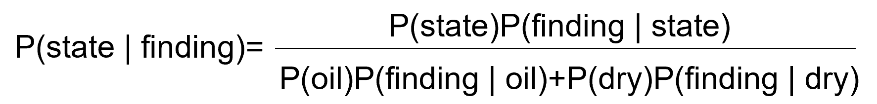
Value of Information
Case: The Goferbroke Company Problem
  The formula for a posterior probability (Baye’s Theorem)
 | P(state | finding)
Finding | Oil | Dry
Favorable (FSS) | P(Oil | FSS) = 1/2 | P(Dry | FSS) = 1/2
Unfavorable (USS) | P(Oil | USS) = 1/7 | P(Dry | USS) = 6/7

Slide 34
Value of Information
Case: The Goferbroke Company Problem
  Decision tree with the survey option

Slide 35
Value of Information
Case: The Goferbroke Company Problem
  Decision tree with the survey option
Sell
Best decision
Do the seismic survey
  If the result is unfavorable, sell the land
  If the result is favorable, drill for oil
The expected payoff is 123
Drill
Do survey
Drill

Slide 36
Outline
Decision Criteria (Chapter 9.1 & 9.2)
Decision Trees and Value of Information (Chapter 9.3-9.7)
Utility Theory Review (Chapter 9.8)
Stochastic Optimization Overview (not in the textbook)
Robust Optimization Overview (not in the textbook)
Probability Basics Review

Slide 37
Utility Theory
Thus far, when applying Bayes’ decision rule, we have assumed that the expected payoff in monetary terms is the appropriate measure.
In many situations, this is inappropriate.
  Accept a 50-50 chance of winning $100,000.
  Receive $40,000 with certainty.
  Many would pick $40,000, even though the expected payoff on the 50-50 chance of winning $100,000 is $50,000. This is because of risk aversion.
A utility function for money is a way of transforming monetary values to an appropriate scale that reflects a decision maker’s preferences (e.g., aversion to risk).

Slide 38
Utility Theory
When a utility function for money is incorporated into a decision analysis approach, it must be constructed to fit the current preferences and values of the decision maker.
When the decision maker’s utility function for money is used, Bayes’ decision rule replaces monetary payoffs by the corresponding utilities.
The optimal decision (or series of decisions) is the one that maximizes the expected utility.
  U(M): utility function for money

Slide 39
Utility Theory
Fundamental Theory:
  Under the assumptions of utility theory, the decision maker’s utility function for money has the property that the decision maker is indifferent between two alternatives if the two alternatives have the same expected utility.
25% chance of $100,000 =
$10,000 for sure
Both have E(Utility) = 0.25.
50% chance of $100,000 =
$30,000 for sure
Both have E(Utility) = 0.5.
75% chance of $100,000 =
$60,000 for sure
Both have E(Utility) = 0.75.

Slide 40
Utility Theory
Creating a utility function:
  Determine the largest potential payoff, M=Maximum.
    Assign U(Maximum) = 1.
  Determine the smallest potential payoff, M=Minimum.
    Assign U(Minimum) = 0.
  To determine the utility of another potential payoff M, consider the two alternatives:
    A₁: Obtain a payoff of Maximum with probability p.
    Obtain a payoff of Minimum with probability 1–p.
    A₂: Definitely obtain a payoff of M.
  Question to the decision maker: What value of p makes you indifferent?
  Then, U(M) = p.
  Various functions:
    Risk Averse: U(t_{a}) = R(1-e^{-t/R})
    Risk Neutral: U(t_{n}) = at + b
    Risk Seekers: U(t_{s}) = t²/c

Slide 41
Outline
Decision Criteria (Chapter 9.1 & 9.2)
Decision Trees and Value of Information (Chapter 9.3-9.7)
Utility Theory Review (Chapter 9.8)
Stochastic Optimization Overview (not in the textbook)
Robust Optimization Overview (not in the textbook)
Probability Basics Review

Slide 42
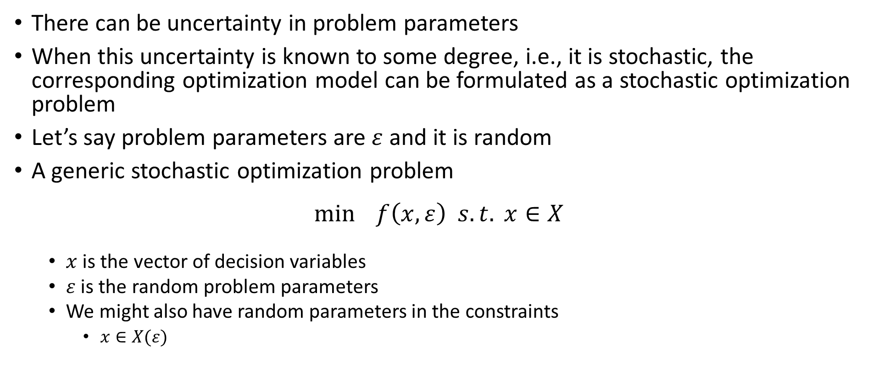
Stochastic Optimization
There can be uncertainty in problem parameters
When this uncertainty is known to some degree, i.e., it is stochastic, the corresponding optimization model can be formulated as a stochastic optimization problem
Let’s say problem parameters are $ε$ and it is random
A generic stochastic optimization problem
$$\min{f\left(x,ε\right) s.t. x∈X}$$
  $x$ is the vector of decision variables
  $ε$ is the random problem parameters
  We might also have random parameters in the constraints
    $x∈X(ε)$

Slide 43
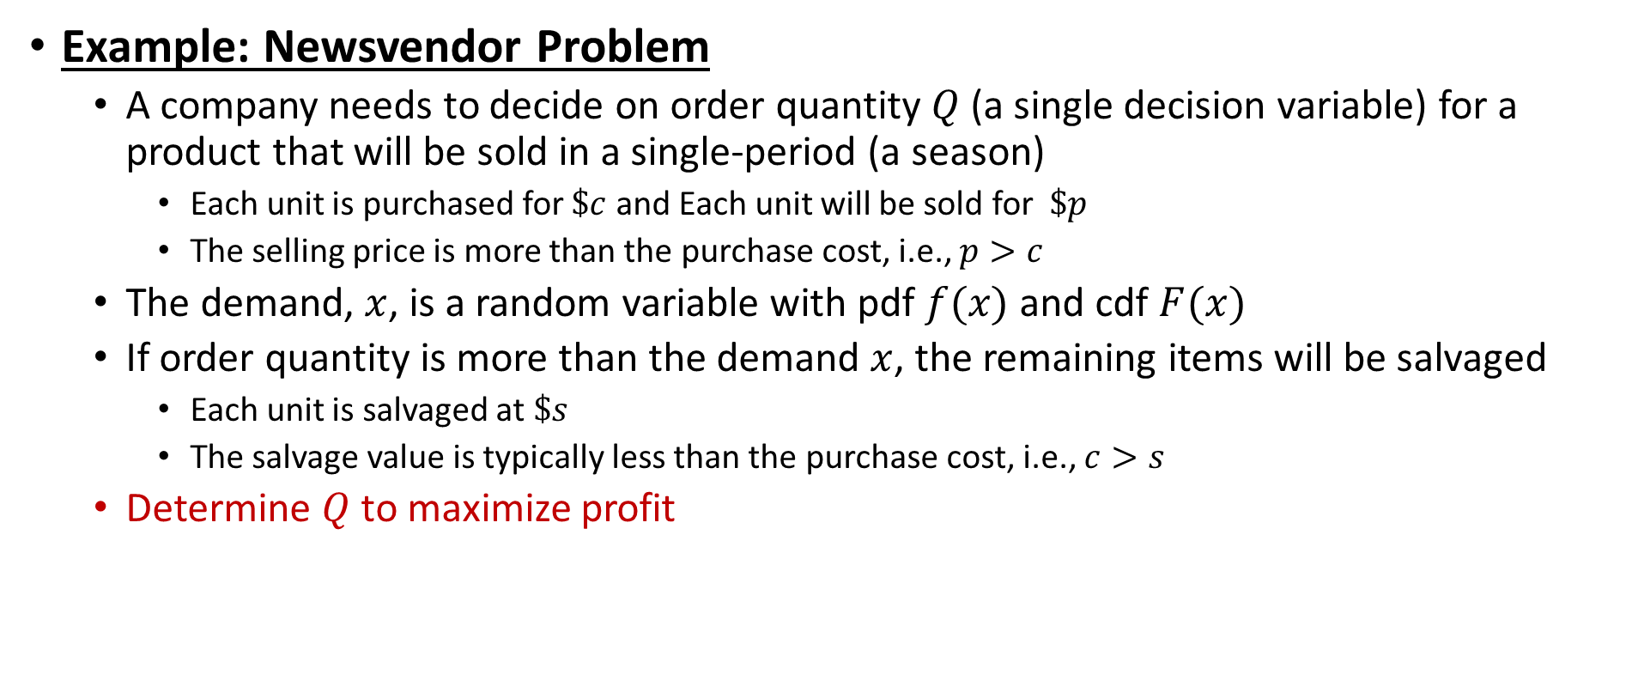
Stochastic Optimization
Example: Newsvendor Problem
  A company needs to decide on order quantity $Q$ (a single decision variable) for a product that will be sold in a single-period (a season)
    Each unit is purchased for $\$c$ and Each unit will be sold for $\$p$
    The selling price is more than the purchase cost, i.e., $p>c$
  The demand, $x$, is a random variable with pdf $f(x)$ and cdf $F(x)$
  If order quantity is more than the demand $x$, the remaining items will be salvaged
    Each unit is salvaged at $\$s$
    The salvage value is typically less than the purchase cost, i.e., $c>s$
  Determine $Q$ to maximize profit

Slide 44
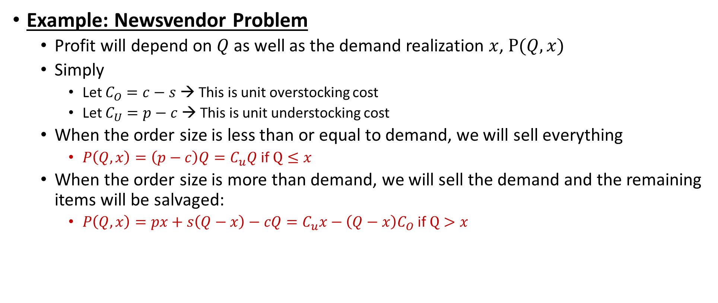
Stochastic Optimization
Example: Newsvendor Problem
  Profit will depend on $Q$ as well as the demand realization $x$, $P(Q,x)$
  Simply
    Let $C_{O}=c−s$ → This is unit overstocking cost
    Let $C_{U}=p−c$ → This is unit understocking cost
  When the order size is less than or equal to demand, we will sell everything
    $P\left(Q,x\right)={\left(p−c\right)Q=C}_{u}Q$ if $Q≤x$
  When the order size is more than demand, we will sell the demand and the remaining items will be salvaged:
    $P\left(Q,x\right)={px+s\left(Q−x\right)−cQ=C}_{u}x−\left(Q−x\right)C_{O}$ if $Q>x$

Slide 45
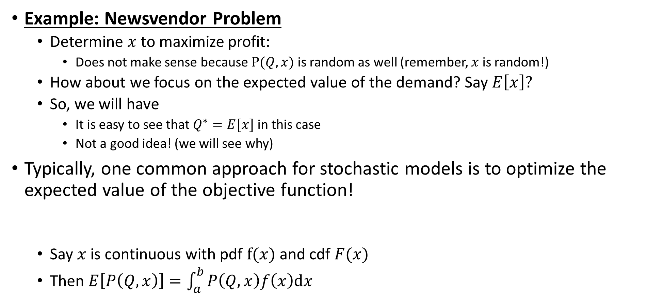



Stochastic Optimization
Example: Newsvendor Problem
  Determine $x$ to maximize profit:
    Does not make sense because $P(Q,x)$ is random as well (remember, $x$ is random!)
  How about we focus on the expected value of the demand? Say $E\left[x\right]?$
  So, we will have
    It is easy to see that $Q^{∗}=E[x]$ in this case
    Not a good idea! (we will see why)
Typically, one common approach for stochastic models is to optimize the expected value of the objective function!
  Say $x$ is continuous with pdf $f(x)$ and cdf $F(x)$
  Then $E\left[P\left(Q,x\right)\right]=\int_{a}^{b}{P\left(Q,x\right)f\left(x\right)dx}$
$$\max{P\left(Q,x\right) s.t. Q≥0}$$
$$\max{P\left(Q,E[x]\right) s.t. Q≥0}$$
$$\max{E[P\left(Q,x\right)] s.t. Q≥0}$$

Slide 46
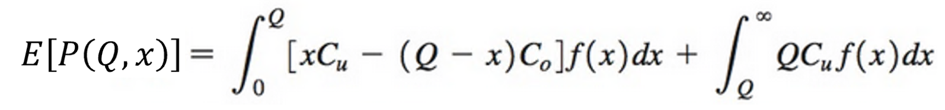
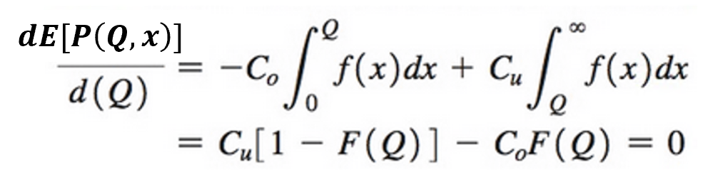
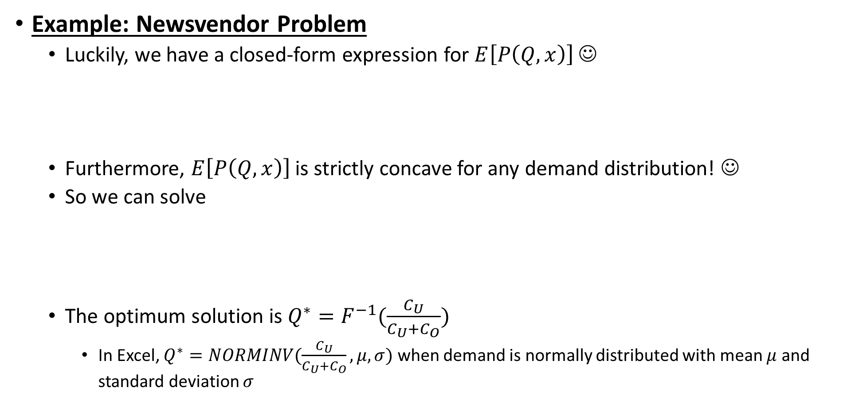

Stochastic Optimization
Example: Newsvendor Problem
  Luckily, we have a closed-form expression for $E\left[P\left(Q,x\right)\right]$ ☺
  Furthermore, $E\left[P\left(Q,x\right)\right]$ is strictly concave for any demand distribution! ☺
  So we can solve
  The optimum solution is $Q^{∗}=F^{−1}(\frac{C_{U}}{C_{U}+C_{O}})$
    In Excel, $Q^{∗}=NORMINV(\frac{C_{U}}{C_{U}+C_{O}},μ,σ)$ when demand is normally distributed with mean $μ$ and standard deviation $σ$
$$\max{E[P\left(Q,x\right)] s.t. Q≥0}$$

Slide 47
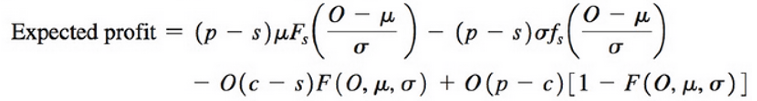
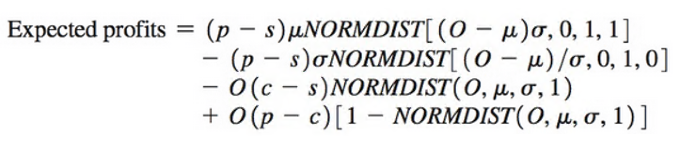
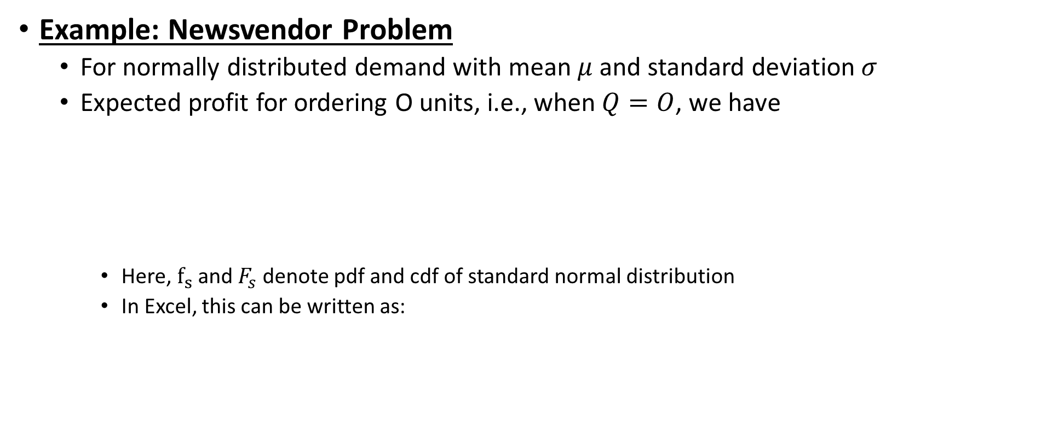
Stochastic Optimization
Example: Newsvendor Problem
  For normally distributed demand with mean $μ$ and standard deviation $σ$
  Expected profit for ordering O units, i.e., when $Q=O$, we have
    Here, $f_{s}$ and $F_{s}$ denote pdf and cdf of standard normal distribution
    In Excel, this can be written as:

Slide 48
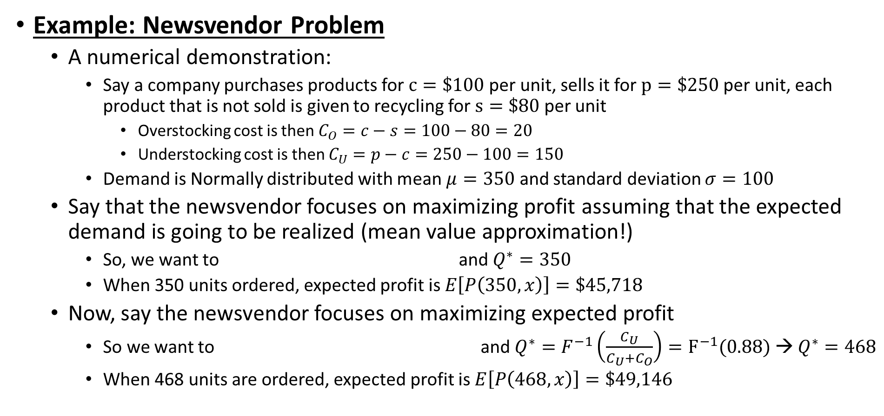


Stochastic Optimization
Example: Newsvendor Problem
  A numerical demonstration:
    Say a company purchases products for $c=\$100$per unit, sells it for $p=\$250$per unit, each product that is not sold is given to recycling for $s=\$80$per unit
      Overstocking cost is then $C_{O}=c−s=100−80=20$
      Understocking cost is then $C_{U}=p−c=250−100=150$
    Demand is Normally distributed with mean $μ=350$ and standard deviation $σ=100$
  Say that the newsvendor focuses on maximizing profit assuming that the expected demand is going to be realized (mean value approximation!)
    So, we want to and $Q^{∗}=350$
    When 350 units ordered, expected profit is $E\left[P\left(350,x\right)\right]=\$45,718$
  Now, say the newsvendor focuses on maximizing expected profit
    So we want to and $Q^{∗}=F^{−1}\left(\frac{C_{U}}{C_{U}+C_{O}}\right)=F^{−1}(0.88)$ → $Q^{∗}=468$
    When 468 units are ordered, expected profit is $E\left[P\left(468,x\right)\right]=\$49,146$
$$\max{P\left(Q,350\right) s.t. Q≥0}$$
$$\max{E[P\left(Q,x\right)] s.t. Q≥0}$$

Slide 49
Stochastic Optimization
Solution approaches
  Deterministic (point-estimate) approach:
    →use expected values of the random parameters
    →formulate a deterministic model with those
    →solve the corresponding deterministic model
    Issues:
      Not necessarily going to optimize the expected value of the objective function!
      When the random parameters are in the constraints?
        The returned solution can be infeasible for a set of values for the random parameters
  Stochastic Expectation approach:
    → optimize the expected value of the objective function (this is similar to Baye’s Rule)
    Issue:
      Deriving the expected objective function: not possible in most cases
      When the random parameters are in the constraints?
      It does not consider risks

Slide 50
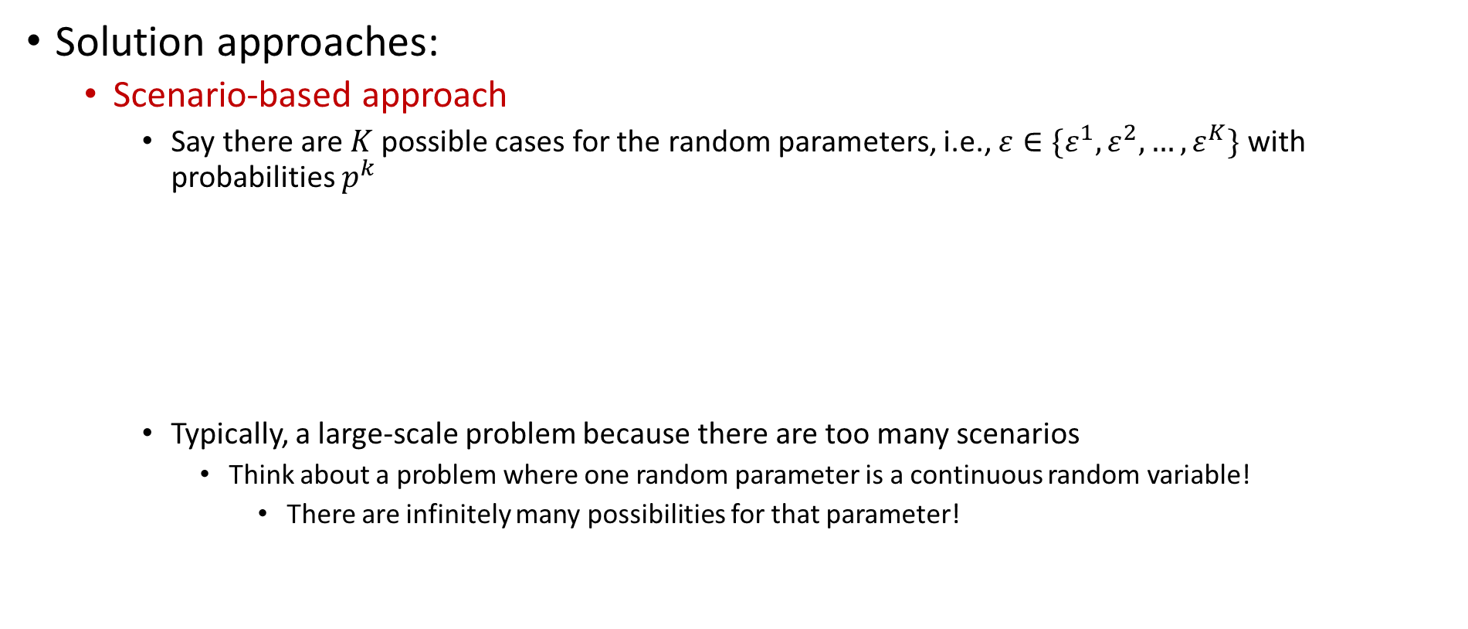
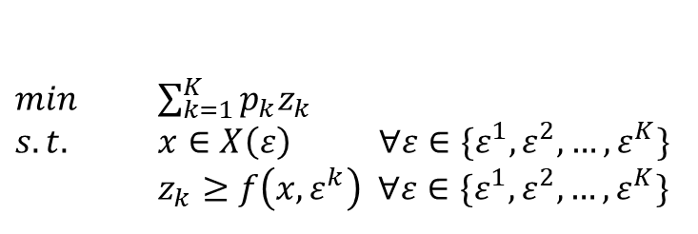
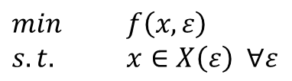
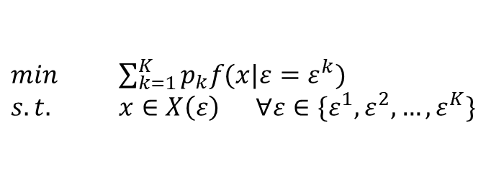
Stochastic Optimization
Solution approaches:
  Scenario-based approach
    Say there are $K$ possible cases for the random parameters, i.e., $ε∈\{ε^{1},ε^{2},…,ε^{K}\}$ with probabilities $p^{k}$
    Typically, a large-scale problem because there are too many scenarios
      Think about a problem where one random parameter is a continuous random variable!
        There are infinitely many possibilities for that parameter!
$min$ $f\left(x,ε\right)$
$s.t.$ $x∈X\left(ε\right) ∀ε$
$min$ $\sum_{k=1}^{K}{p_{k}f(x|ε=ε^{k})}$
$s.t.$ $x∈X\left(ε\right) ∀ε∈\{ε^{1},ε^{2},…,ε^{K}\}$
$min$ $\sum_{k=1}^{K}{p_{k}z_{k}}$
$s.t.$ $x∈X\left(ε\right) ∀ε∈\{ε^{1},ε^{2},…,ε^{K}\}$
$z_{k}≥f\left(x,ε^{k}\right) ∀ε∈\{ε^{1},ε^{2},…,ε^{K}\}$

Slide 51
Stochastic Optimization
Solution approaches:
  Simulation-based approaches
    Monte-Carlo Sampling
      Generate a set of scenarios
      Average performance of a solution over those scenarios is its performance
      Pick the solution with the best average performance
      Typically, search over the solution space
    Or
      Pick a solution
      Evaluate its performance with simulation
      Search over the solution space

Slide 52
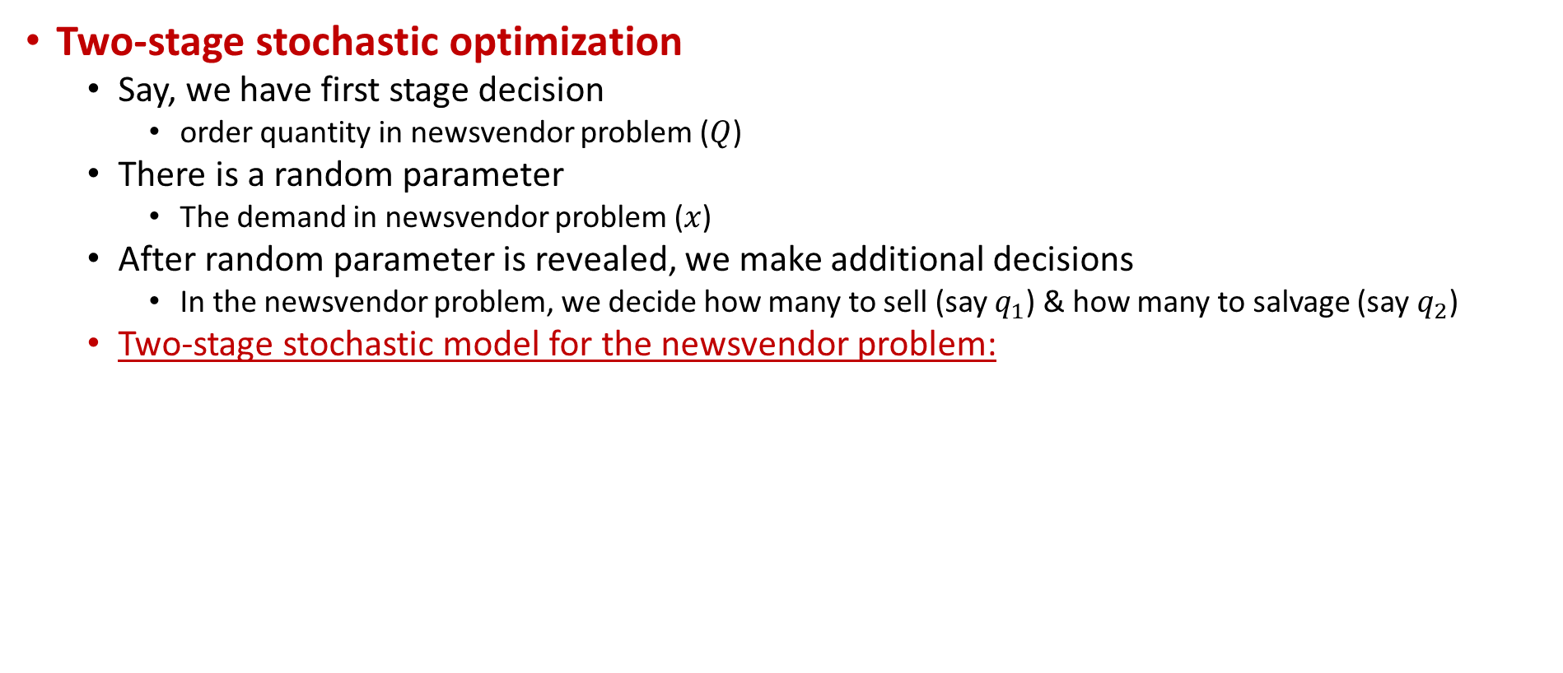

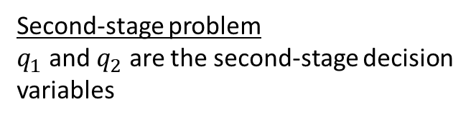
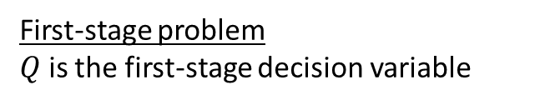
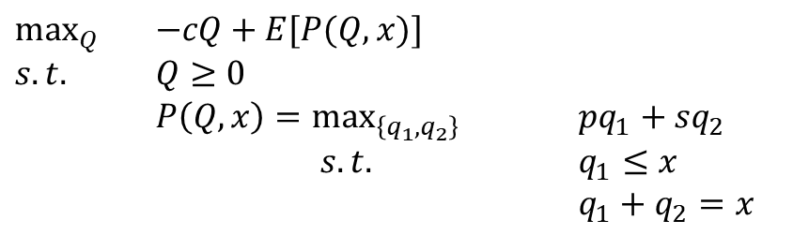
Stochastic Optimization
Two-stage stochastic optimization
  Say, we have first stage decision
    order quantity in newsvendor problem ($Q$)
  There is a random parameter
    The demand in newsvendor problem ($x$)
  After random parameter is revealed, we make additional decisions
    In the newsvendor problem, we decide how many to sell (say $q_{1}$) & how many to salvage (say $q_{2}$)
  Two-stage stochastic model for the newsvendor problem:
$\max_{Q}{ }$ $−cQ+E[P(Q,x)]$
$s.t.$ $Q≥0$
$P\left(Q,x\right)=\max_{\left\{q_{1},q_{2}\right\}}{ }$ $pq_{1}+sq_{2}$
$s.t.$ $q_{1}≤x$
$q_{1}+q_{2}=x$
First-stage problem
$Q$ is the first-stage decision variable
Second-stage problem
$q_{1}$ and $q_{2}$ are the second-stage decision variables
$P\left(Q,x\right)$ is the recourse function

Slide 53
Stochastic Optimization
Two-stage stochastic optimization
  In the newsvendor example, the second-stage model has an explicit solution, thus, newsvendor problem is easy to solve
  But, most of the times, second-stage problem can be challenging to solve
  Different approaches are proposed!
Other points:
  Chance constraints!
    Add constraints that probability of some situation happening is bounded
      Maximize profit such that probability of not satisfying the demand is less than 10%
  Other approaches
    Risk-averse, risk-taking
    Regret

Slide 54
Outline
Decision Criteria (Chapter 9.1 & 9.2)
Decision Trees and Value of Information (Chapter 9.3-9.7)
Utility Theory Review (Chapter 9.8)
Stochastic Optimization Overview (not in the textbook)
Robust Optimization Overview (not in the textbook)
Probability Basics Review

Slide 55
Robust Optimization
In deterministic optimization → all parameters are deterministic
In stochastic optimization → some parameters are stochastic
  That is, they are subject to known uncertainty
  We have some probability distributions and statistical knowledge
In robust optimization → some parameters are uncertain
  We do not have much information about their uncertainty
  Probabilities are not known, or not reliable (because of lack of data), or changing
We have already discussed some decision criteria for selecting an alternative from a given set of alternatives
  Maximax, maximin…
Robust optimization is similar, but our alternatives are defined in a feasible set!
  That is, too many (maybe infinitely many) alternatives (solutions)!
  So, we take an optimization approach!

Slide 56
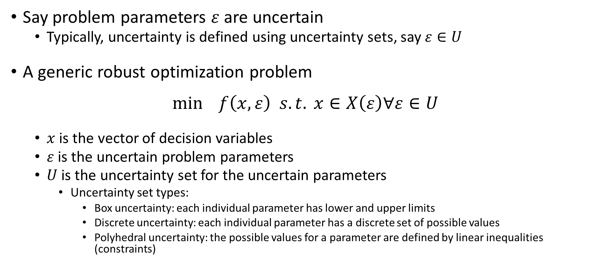
Robust Optimization
Say problem parameters $ε$ are uncertain
  Typically, uncertainty is defined using uncertainty sets, say $ε∈U$
A generic robust optimization problem
$$\min{f\left(x,ε\right) s.t. x∈X\left(ε\right)∀ε∈U}$$
  $x$ is the vector of decision variables
  $ε$ is the uncertain problem parameters
  $U$ is the uncertainty set for the uncertain parameters
    Uncertainty set types:
      Box uncertainty: each individual parameter has lower and upper limits
      Discrete uncertainty: each individual parameter has a discrete set of possible values
      Polyhedral uncertainty: the possible values for a parameter are defined by linear inequalities (constraints)

Slide 57
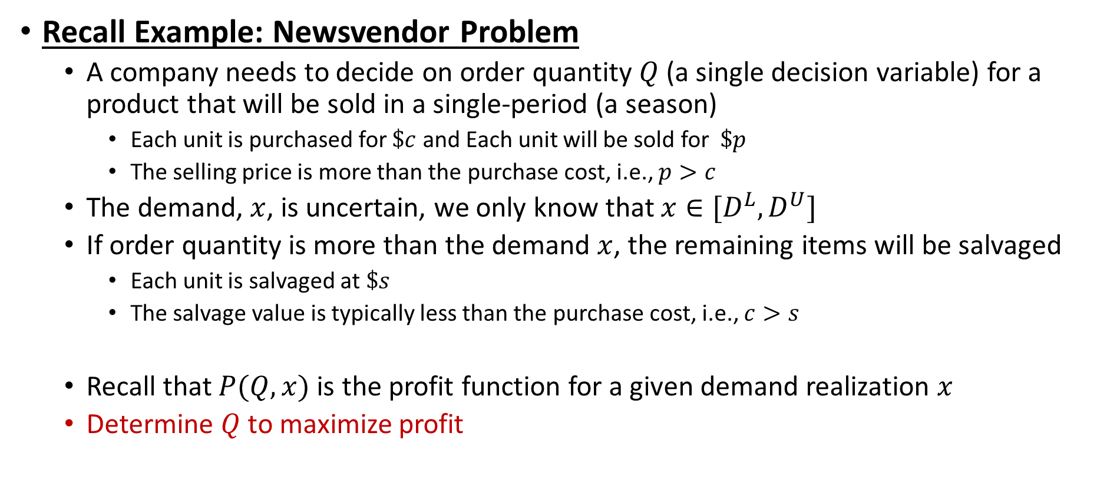
Robust Optimization
Recall Example: Newsvendor Problem
  A company needs to decide on order quantity $Q$ (a single decision variable) for a product that will be sold in a single-period (a season)
    Each unit is purchased for $\$c$ and Each unit will be sold for $\$p$
    The selling price is more than the purchase cost, i.e., $p>c$
  The demand, $x$, is uncertain, we only know that $x∈[D^{L},D^{U}]$
  If order quantity is more than the demand $x$, the remaining items will be salvaged
    Each unit is salvaged at $\$s$
    The salvage value is typically less than the purchase cost, i.e., $c>s$
  Recall that $P(Q,x)$ is the profit function for a given demand realization $x$
  Determine $Q$ to maximize profit

Slide 58
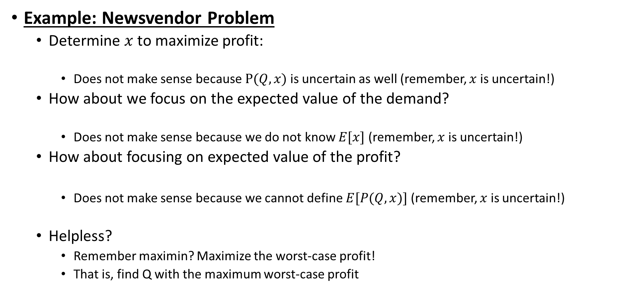



Robust Optimization
Example: Newsvendor Problem
  Determine $x$ to maximize profit:
    Does not make sense because $P(Q,x)$ is uncertain as well (remember, $x$ is uncertain!)
  How about we focus on the expected value of the demand?
    Does not make sense because we do not know $E[x]$ (remember, $x$ is uncertain!)
  How about focusing on expected value of the profit?
    Does not make sense because we cannot define $E[P(Q,x)]$ (remember, $x$ is uncertain!)
  Helpless?
    Remember maximin? Maximize the worst-case profit!
    That is, find Q with the maximum worst-case profit
$$\max{P\left(Q,x\right) s.t. Q≥0}$$
$$\max{P\left(Q,E[x]\right) s.t. Q≥0}$$
$$\max{E[P\left(Q,x\right)] s.t. Q≥0}$$

Slide 59
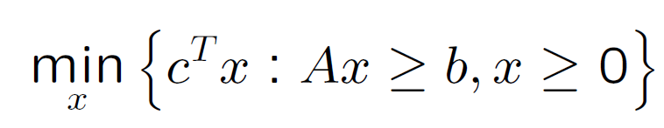
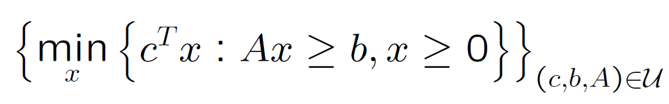
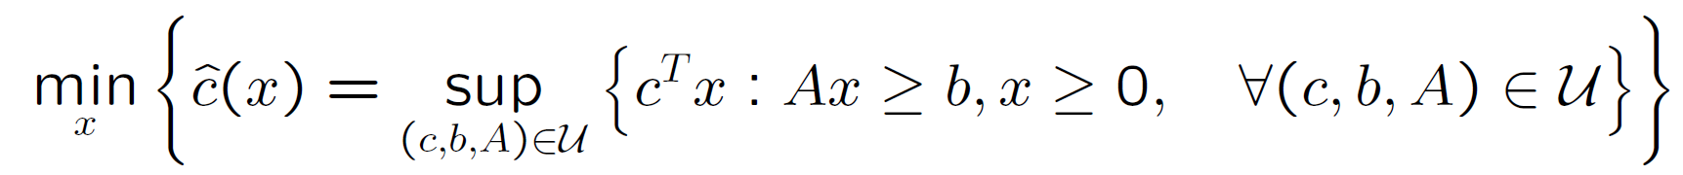
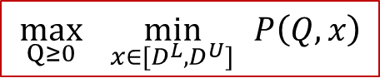
Robust Optimization
Example: Newsvendor Problem
  Worst-case approach (maximin!)
A generic linear programming model
  Deterministic model:
  Uncertain model:
  Robust counterpart:
      How about we take the dual of the inner problem?
      Then, we will have minmin → which can be expressed as min only!
$$\max_{Q≥0}{\min_{x∈[D^{L},D^{U}]}{ }P\left(Q,x\right)}$$
Known as the robust-counter

Slide 60
Robust Optimization
Robust optimization problems are typically hard to solve
  When the uncertainty is present in the constraints
  Robust-feasible solution: A solution that is always feasible (for any possible parameter values)
Solution approaches:
  For continuously uncertain problems, there might be infinitely many constraints
  Conic programming, semi-definite programming, etc.

Slide 61
Outline
Decision Criteria (Chapter 9.1 & 9.2)
Decision Trees and Value of Information (Chapter 9.3-9.7)
Utility Theory Review (Chapter 9.8)
Stochastic Optimization Overview (not in the textbook)
Robust Optimization Overview (not in the textbook)
Probability Basics Review

Slide 62
Discrete Random Variables
Suppose we have an experiment whose outcome depends on chance
  The outcome of the experiment is called random variable
  The sample space of the experiment is the set of all possible outcomes.
  A Random Variable, X, is said to be discrete if it can take on at most a countable (finite) number of values
    That is, the sample space is finite
  A subset of the sample space is called event

Slide 63
Discrete Random Variables
Rolling a standard six-sided die
  6 possible outcomes
    Sample space, S={1,2,3,4,5,6}
  X is the outcome we get
    X is a random variable
Probability of having 4 after we roll is 1/6
event

Slide 64
Discrete Random Variables
Rolling a standard six-sided die
  What is the probability of having an even number?
  6 possible outcomes after we roll
  Our event E={2,4,6} → P(E)=1/6+1/6+1/6=1/2

Slide 65

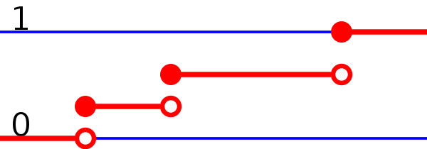
Discrete Random Variables
P(X=x) = “Probability that X takes on the value x”
  0 ≤ P(X=x) ≤ 1
  Σ P(X=x) =1
Probability of an event is the sum of the probabilities of the outcomes in this event
Probability distribution function (pdf) = f(X)
Cumulative distribution function (cdf) = F(X)

Slide 66
Discrete Random Variables
E[X] = “expected value of the X”
  E[X] = Σ x P(X=x)
V[X] = “variance of the X”
  V[X] =Σ x² P(X=x) – E[X]²
  V[X]= Σ P(X=x)(x – E[X])²
SD[X] = “standard deviation of X”
  SD[X] = √V[X]
Rolling a die

Slide 67
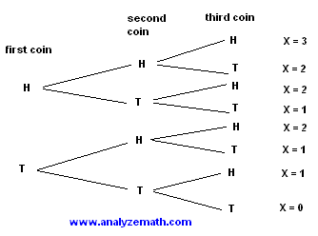
Discrete Random Variables
Three coins are tossed. Let X be the number of heads obtained. Construct a probability distribution for X and find its mean and standard deviation.
E[X]= 0 * (1/8) + 1 * (3/8) + 2 * (3/8) + 3 * (1/8) = 1.5
X | P(X)
0 | 1 / 8
1 | 3 / 8
2 | 3 / 8
3 | 1 / 8
V[X]= (0 - 1.5) ² * (1/8) + (1 - 1.5) ² * (3/8) + (2 - 1.5) ² * (3/8) + (3 - 1.5) ² * (3/8)= 1.11

Slide 68
Expectation and Variance
Recall that
  E[X] = Σ x P(X=x)
We have the following properties
  E[X+c]=E[X]+c where c is a constant
  E[aX]=aE[X] where a is a constant
  E[aX+bY]=aE[X]+bE[Y] where Y is also a random variable
Recall that
  V[X] =Σ x² P(X=x) – E[X]²
We have the following properties
  V[X+c]=V[X] where c is a constant
  V[aX]=a²V[X] where a is a constant
  V[aX+bY]= a²V[X]+ b²V[Y] if X and Y are independent variables

Slide 69

Expectation and Variance
Multiplication of two random variables
  Suppose Z = XY,
  X and Y are independent random variables
    That is, if P(X $∩$Y) = P(X)P(Y)
  THEN Z is a random variable with
    E[Z] = E[X]E[Y]
    V[Z] = V[X]E[Y]² + V[Y]E[X]² + V[X]V[Y]

Slide 70
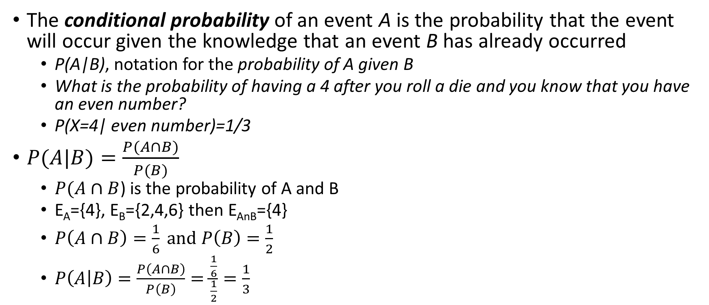
Conditional Probability
The conditional probability of an event A is the probability that the event will occur given the knowledge that an event B has already occurred
  P(A|B), notation for the probability of A given B
  What is the probability of having a 4 after you roll a die and you know that you have an even number?
  P(X=4| even number)=1/3
$P(A|B)=\frac{P(A∩B)}{P(B)}$
  $P(A∩B$) is the probability of A and B
  E_{A}={4}, E_{B}={2,4,6} then E_{AnB}={4}
  $P\left(A∩B\right)=\frac{1}{6} and P\left(B\right)=\frac{1}{2}$
  $P\left(A | B\right)=\frac{P\left(A∩B\right)}{P\left(B\right)}=\frac{\frac{1}{6}}{\frac{1}{2}}=\frac{1}{3}$

Slide 71
Discrete Distributions
Bernoulli (yes-no) distribution:
  Two outcomes: whether an event occurs or not
Binomial Distribution:
  Describes the number of times an event occurs in a fixed number of trials (e.g., number of heads in 10 flips of a coin)
  For each trial, only two outcomes possible
  Trials are independent
  Probability remains the same for each trial
Geometric Distribution:
  Describes the number of trials until an event occurs (e.g., number of times to roll a die until you get 6)
  Same probability for each trial
  Continue until succeed, unlimited trials

Slide 72
Discrete Distributions
Negative Binomial Distribution:
  Describes the number of trials until an event occurs n times
  Similar to geometric (when n=1, you have geometric distribution)
Poisson Distribution:
  Describes the number of times an event occurs during a given period of time or space
  Occurrences are independent
  Any number of events is possible
Discrete Uniform Distribution:
  Each outcome is equally likely
  Rolling a dice, each outcome is ½ probability
Read Chapter 13.7

Slide 73
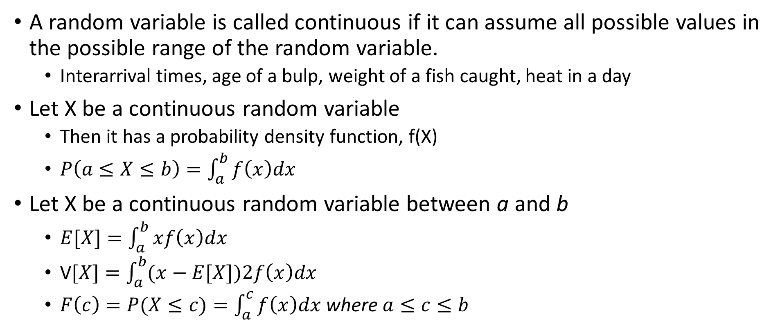
Continuous Random Variables
A random variable is called continuous if it can assume all possible values in the possible range of the random variable.
  Interarrival times, age of a bulp, weight of a fish caught, heat in a day
Let X be a continuous random variable
  Then it has a probability density function, f(X)
  $P\left(a≤X≤b\right)=\int_{a}^{b}{f\left(x\right)dx}$
Let X be a continuous random variable between a and b
  $E[X]=\int_{a}^{b}{xf\left(x\right)dx}$
  V$[X]=\int_{a}^{b}{(x−E[X])2f\left(x\right)dx}$
  $F\left(c\right)=P(X≤c)=\int_{a}^{c}{f\left(x\right)dx}$ where $a≤c≤b$

Slide 74
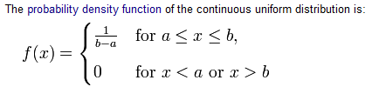
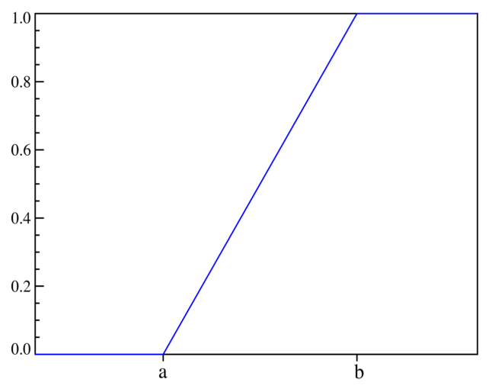
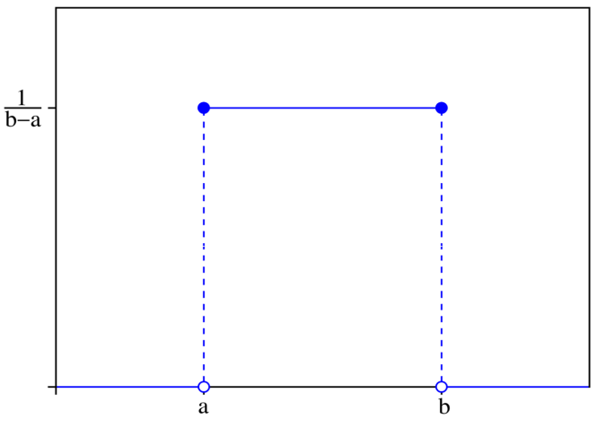
Continuous Distributions
Uniform Distribution
Triangular Distribution
Normal Distribution
Exponential Distribution
Gamma Distribution
Erlang Distribution
Lognormal Distribution
Read Chapter 13.7
Uniform distribution example

